Slide 1

Hire Smart Smart Resume Scanner and Analyzer
Team Member:
1.Neha
2.Kalyan
3.Rohit

Slide 2
Introduction:
This project is focused on building a web application that helps users and recruiters to evaluate the resumes and match them with job descriptions.
The core functionality of the application is to allow users and recruiters to upload the resumes and job descriptions, then analyze how well the resume matches the job role based on key skills and requirements.
The primary objective of this web application is to assist both job seekers and recruiters in improving the hiring process by automating the evaluation of resumes and job descriptions.

Slide 3
Problem Statement:
The Challenges
Job Seekers: Struggle to tailor resumes to job descriptions, leading to missed opportunities due to skill gaps and poor resume optimization.
Recruiters: Spend excessive time manually screening resumes, making it difficult to efficiently identify the best-fit candidates.
Core Problem
Mismatch between resumes and job descriptions, resulting in inefficient hiring and missed job opportunities.

Slide 4
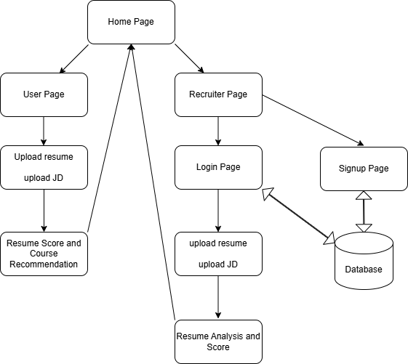
Flow Chart:

Slide 5
Algorithm:
Upload Resume – Accept a resume in PDF, DOCX, or TXT format.
Extract Text – Use PDFPlumber (for PDFs) and python-docx (for DOCX) to extract text content.
Parse Key Sections – Identify sections like Name, Contact Information, Skills, Experience, and Education using Regular Expressions (Regex).
Store Data – Save extracted details in an SQLite3 database for further analysis.
Match Keywords – Compare extracted skills and experience with a predefined job description using text matching techniques.
Calculate Score – Assign a matching score based on keyword similarity and experience level.
Generate Report – Provide a structured output with extracted details, matching percentage, and recommendations.
Display Results – Show results on a Flask-based web interface with an option to download the report.
Handle Errors – Use exception handling to manage unsupported file formats and parsing issues.
Repeat Process – Allow recruiters to upload multiple resumes and compare results.

Slide 6
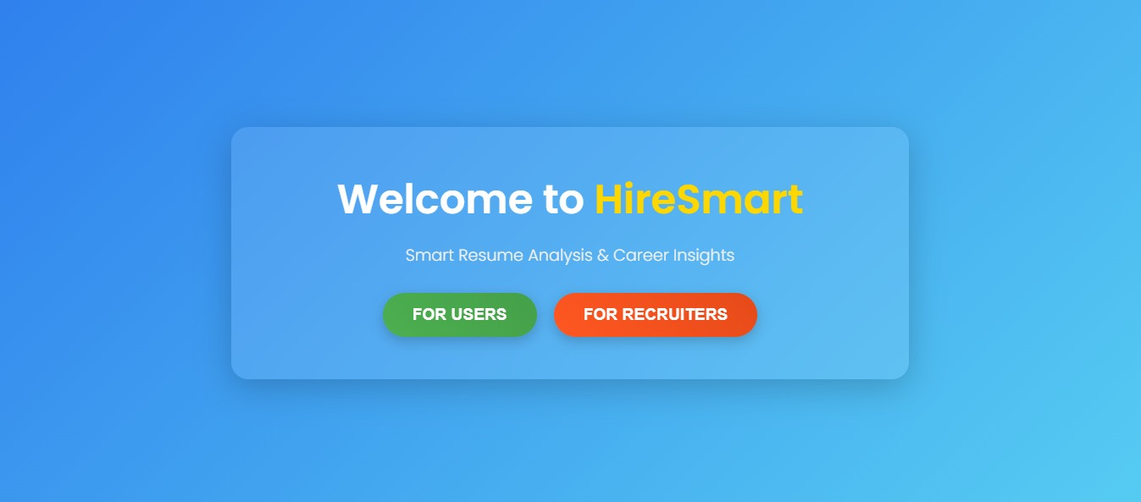
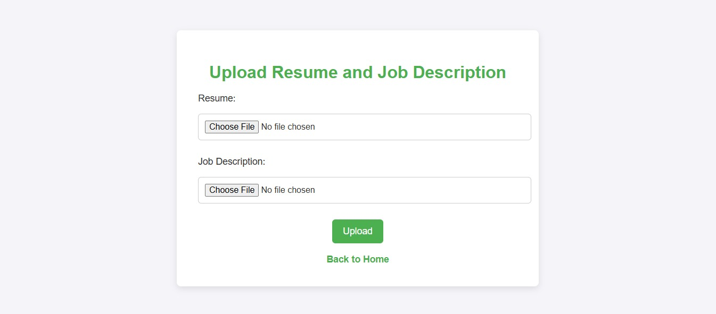
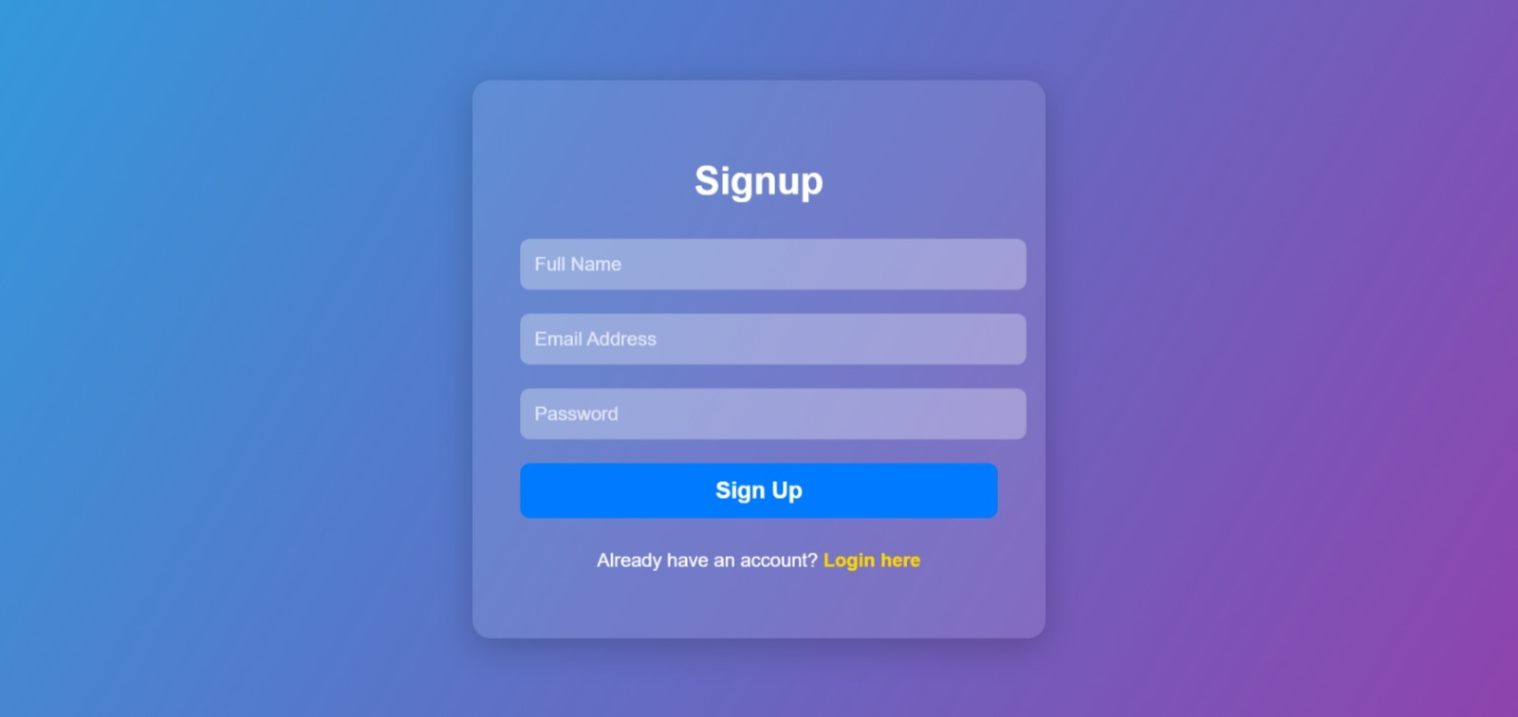
Home Page
Purpose:
A platform for users and recruiters to analyze resumes and gain career insights.
Two main user flows: For Users and For Recruiters.
Key Features:
For Users:
Upload resumes and job descriptions for personalized analysis.
Receive a detailed resume score and suggested courses for skill improvement.
For Recruiters:
Upload multiple resumes and job descriptions for candidate ranking.
Analyze and filter candidates based on scores, skills, and experience.

Slide 7
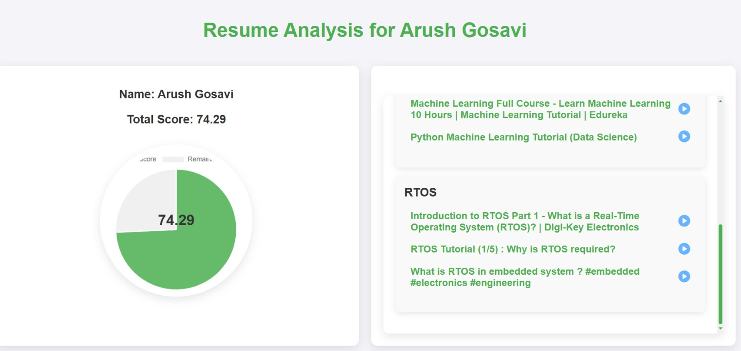
User Page
User Flow:
Upload Resume: Users upload their resume and job description for analysis.
Analysis Results:
Receive a total score based on resume quality and job description match.
Visualized using a pie chart for easy understanding.
Key Features:
Course Suggestions: Links to external resources for skill development.
User-Friendly Design: Clean, intuitive interface with clear navigation.
Design Highlights:
Minimalistic and professional layout.
Use of Chart.js for data visualization.

Slide 8
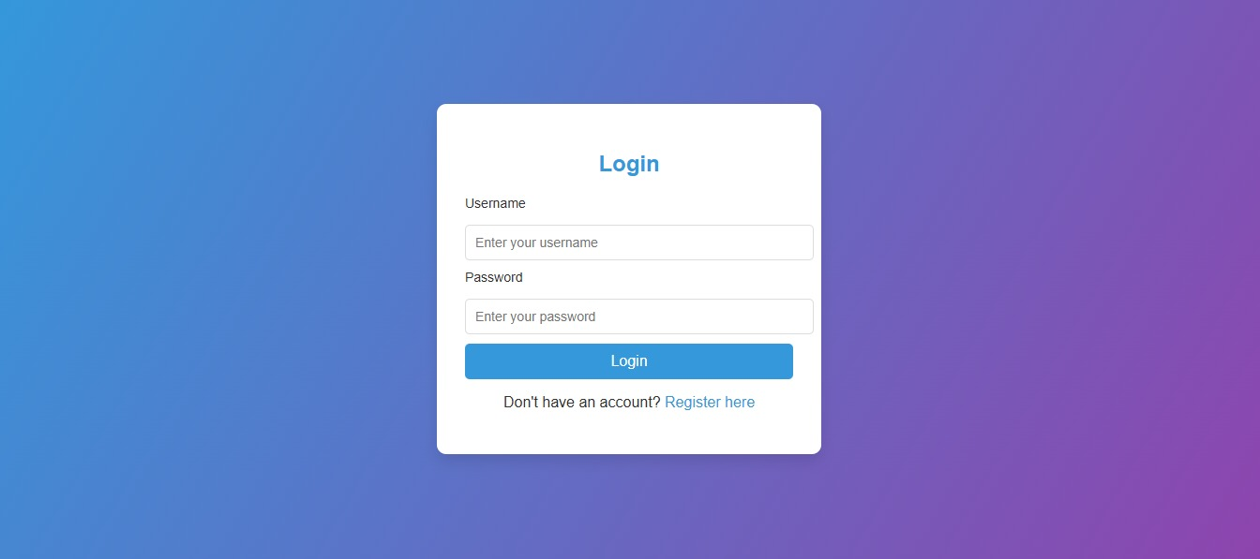
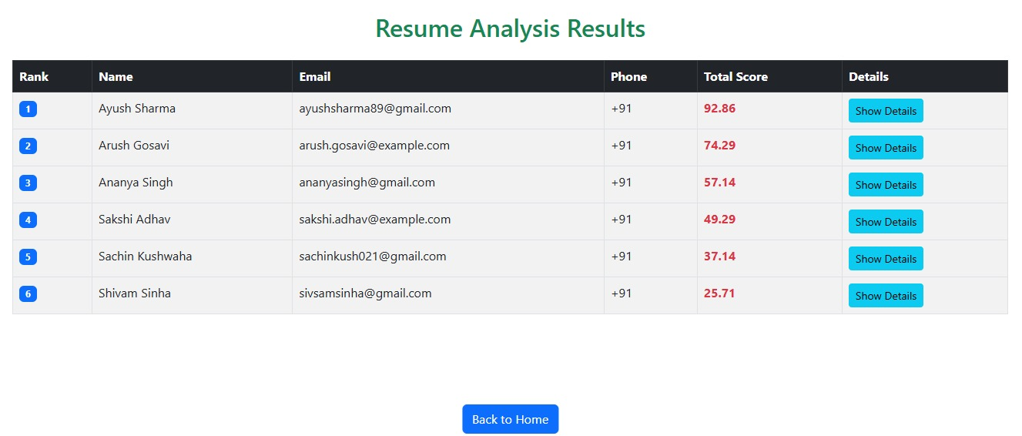
Recruiter Page
Recruiter Flow:
Upload Resumes and Job Descriptions: Recruiters upload multiple resumes and job descriptions for analysis.
Candidate Ranking:
Candidates are ranked based on their total score.
Detailed breakdown of skills, experience, and education.
Expandable Details:
Recruiters can view detailed information for each candidate.
Key Features:
Sticky Table Headers: Easy navigation through large datasets.
Expandable Rows: View full resume details for each candidate.
Back to Home Button: Quick navigation to the homepage.

Slide 9
APPLICATION:
1. For Job Seekers:
Upload resumes and job descriptions to analyze compatibility.
Get personalized skill gap analysis and course recommendations.
Optimize resumes for better job matching.
2. For Recruiters:
Upload and compare resumes with job descriptions.
Get automated candidate compatibility insights.
Save time on manual screening and improve hiring efficiency.
3. Industry Use Cases:
HR & Recruitment Firms – Faster candidate shortlisting.
E-learning Platforms – Skill enhancement recommendations.
Career Counseling Services – Resume improvement insights

Slide 10
Future Scope:
AI-Based Resume Enhancement
Integrating AI-powered resume builders that provide real-time suggestions for improving resume structure, wording, and formatting.
Advanced Skill Gap Analysis
Using machine learning algorithms to provide personalized career growth plans, recommending industry-specific certifications and learning resources.
Integration with Job Portals
Expanding the platform to connect with job portals like LinkedIn, Indeed, and Naukri for direct job applications based on resume-job matching scores.
Real-Time Market Trends & Salary Insights
Providing users with insights into current job market trends, in-demand skills, and expected salary ranges based on their field and experience level.

Slide 11
Conclusion:
This project aims to bridge the gap between job seekers and recruiters by providing an intelligent, automated solution for resume evaluation and job matching. By analyzing resumes against job descriptions, the platform helps candidates optimize their applications while offering recruiters a more efficient way to assess compatibility. Additionally, the system provides personalized skill improvement suggestions, ensuring job seekers can enhance their qualifications. With its ability to streamline the hiring process and improve decision-making, this platform creates a smarter, data-driven approach to recruitment, benefiting both candidates and employers alike.

Slide 12
THANK YOU

